Slide 1
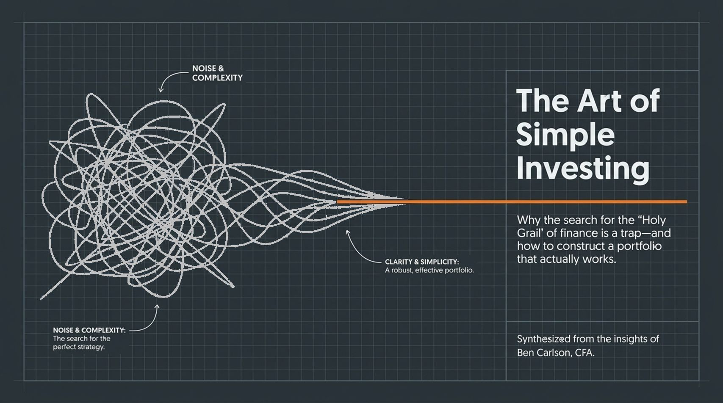
Notes:
Introduction: Welcome, everyone. Today, we're diving into The Art of Simple Investing, synthesized from the insights of Ben Carlson, CFA, author and co-host of Animal Spirits. Looking at the slide, you see two contrasting paradigms: on one side, a blueprint of a ornate Holy Grail representing noise and complexity; on the other, a solid anchor representing clarity and simplicity.
Core Message: In finance, investors are constantly lured into searching for the 'Holy Grail'—a secret strategy that promises all of the upside with none of the downside. But as Ben Carlson notes, the greatest secret to investing is that there is no secret.
Key Takeaway & Transition: Instead of trying to outsmart the market with opaque models, true long-term success comes from anchoring yourself to evidence-based discipline. Over the next 15 slides, we’ll break down how to trim away Wall Street’s noise and build a resilient, simple portfolio that actually works.
https://www.youtube.com/watch?v=7AvuMokBeDo

Slide 2

Notes:
The Myth of the Cheat Code: Even sophisticated investors intuitively know there’s no magic formula. Yet, there’s a deeply ingrained psychological desire for a 'wink-wink' secret path—a way to sidestep every market crash and invest only when the dust has settled.
Why It Fails: In his interview, Carlson highlights that waiting for 'the dust to settle' is a trap. By the time bad news stops making headlines, markets have already priced in the recovery. Trying to find a strategy that delivers market-beating returns with zero drawdown is chasing a phantom.
The Mindset Shift: Success requires giving up the illusion of a financial cheat code. The real breakthrough isn't finding a complex, secret formula; it’s accepting that simplicity beats complexity once you commit to rules-based execution.

Slide 3
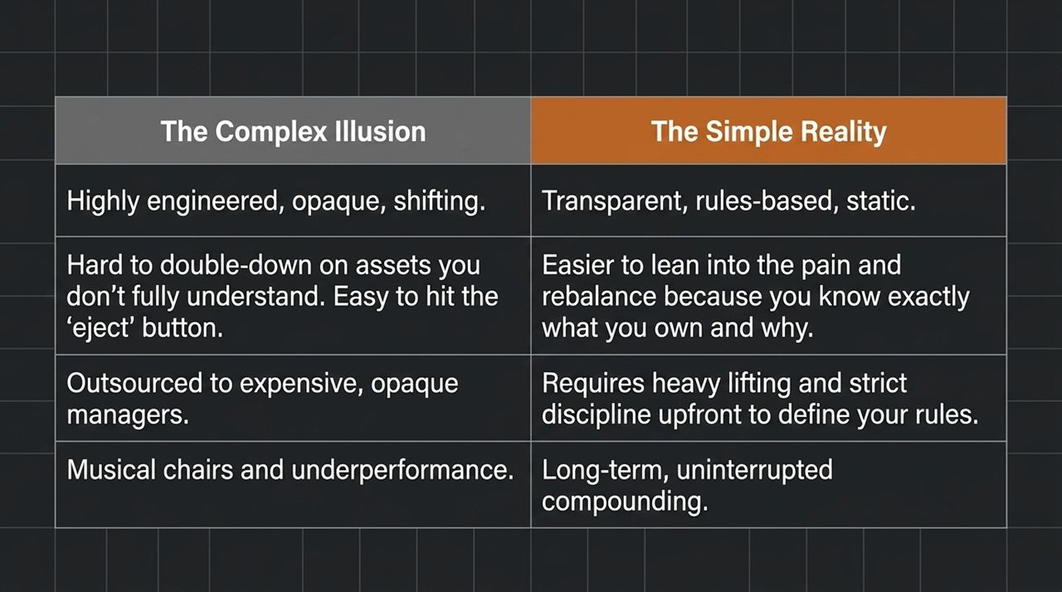
Notes:
Comparing Strategy Types: Let’s look at the side-by-side comparison on this slide. Complex strategies are highly engineered, opaque, and constantly shifting. Simple strategies are transparent, rules-based, and static.
Behavioral Breakdown in Downturns: Why does this matter? During a severe market crash, you face a critical question: Are you willing to double down on your assets when they are losing money? With complex investments, it's very hard to lean into the pain because you don't fully understand what’s inside. It becomes far too easy to panic and hit the 'eject' button.
The Front-Loaded Effort of Simplicity: With simple index-based assets, you know exactly what you own and why you own it. While simple strategies require heavy lifting upfront to set up clear rules, they eliminate the game of 'musical chairs' and let long-term compounding work uninterrupted.

Slide 4
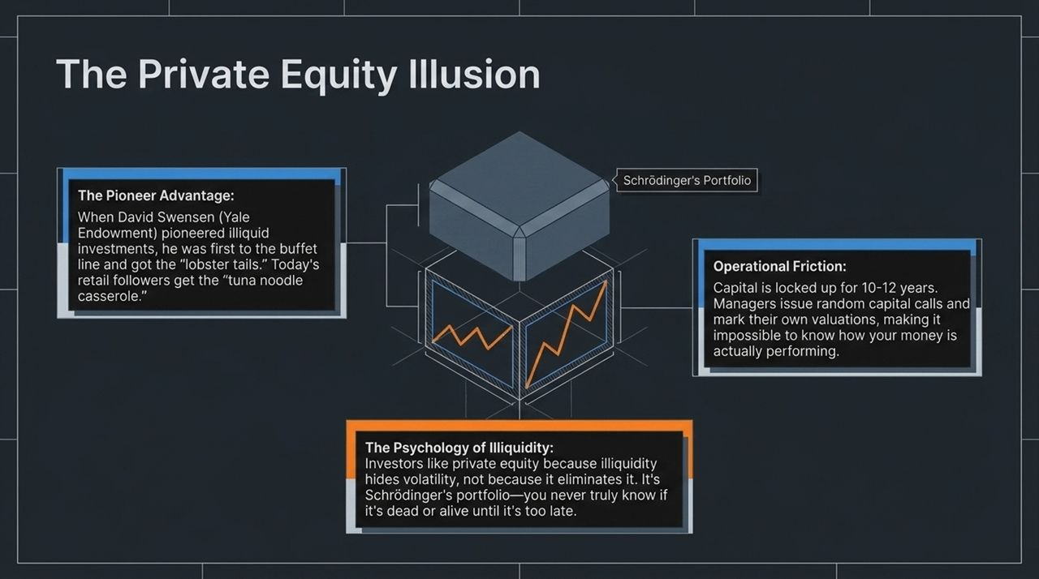
Notes:
The Pioneer Advantage: Private equity is often pitched as the ultimate high-return asset class. When David Swensen pioneered illiquid investments for the Yale Endowment, he was first to the buffet and got the 'lobster tails'. But as Dr. William Bernstein famously noted, retail followers today are left with 'tuna noodle casserole'.
Schrödinger's Portfolio: Carlson describes private equity as 'Schrödinger’s portfolio'. Because private assets aren’t priced daily in public markets, managers mark their own valuations. Investors like private equity not because it eliminates volatility, but because illiquidity hides volatility. You never truly know if the asset is dead or alive until years later.
Operational Friction: Your capital is locked up for 10 to 12 years with unpredictable capital calls. For individual investors, public index markets offer far greater transparency, liquidity, and control.

Slide 5
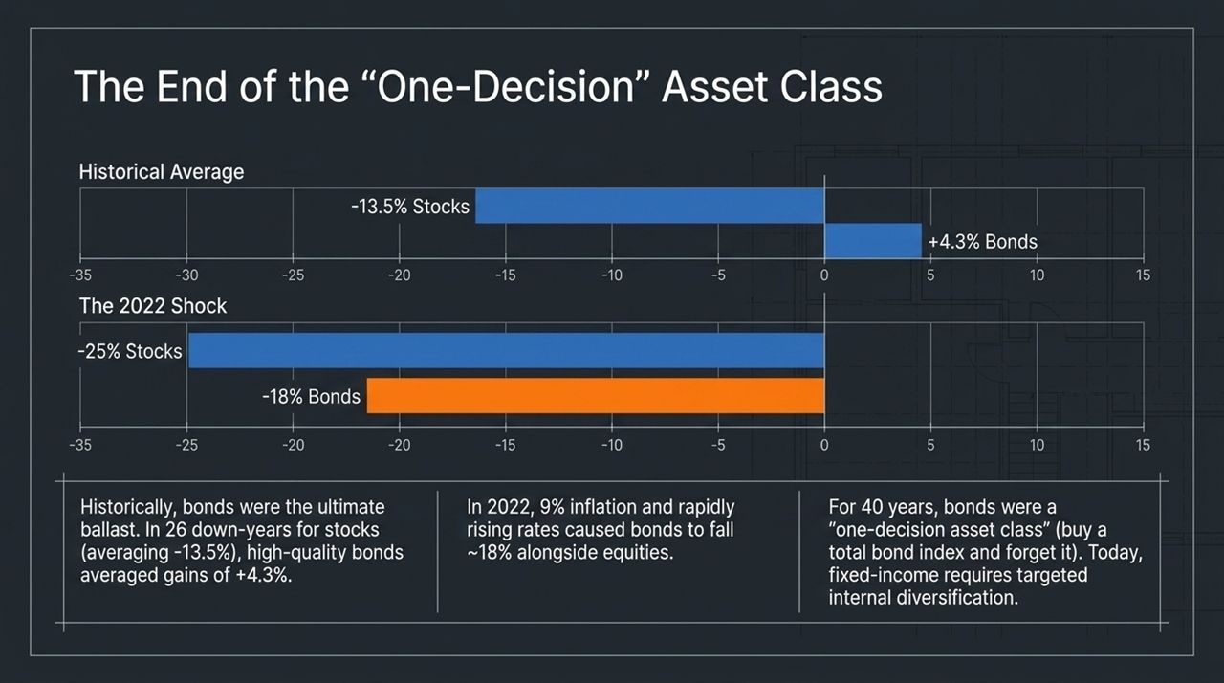
Notes:
Historical Performance: For over 40 years, bonds were considered a 'one-decision asset class'. You bought a total bond market index fund and forgot about it. Historically, during 26 down-years for equities (where stocks dropped an average of -13.5%), high-quality bonds acted as ballast, gaining +4.3% on average.
The 2022 Shock: Then came 2022. Driven by 9% inflation and aggressive rate hikes, bonds fell approximately 18% alongside a 25% drop in equities. Both asset classes cratered together.
Takeaway: Does this mean bonds are broken? No. But it proves that holding a single total bond fund leaves you exposed to duration risk when interest rates spike rapidly. Modern fixed-income portfolios require internal diversification.

Slide 6
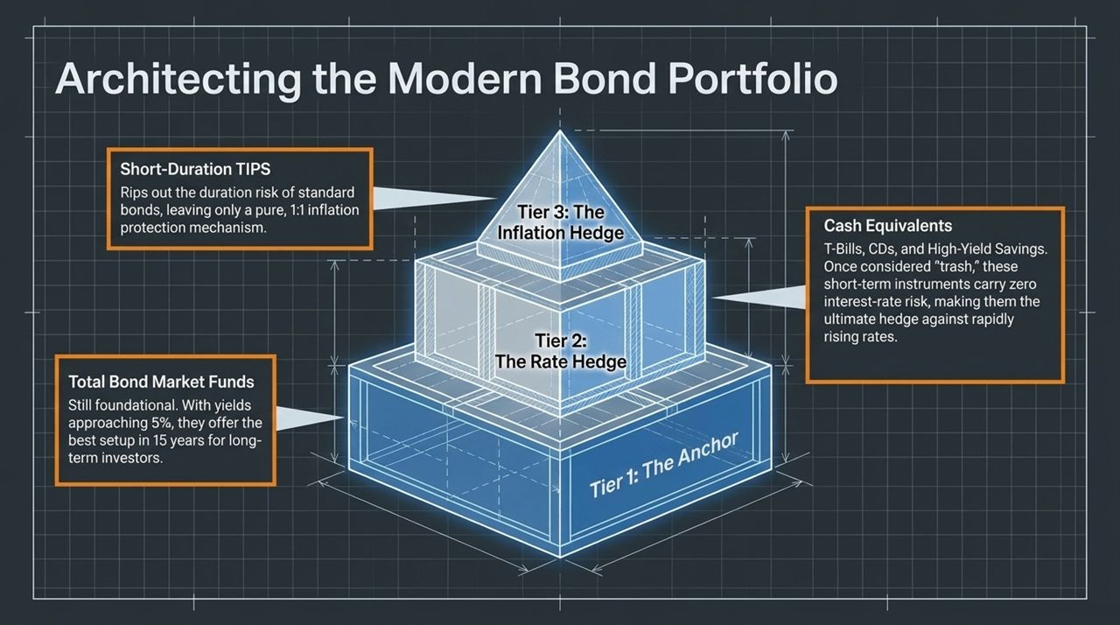
Notes:
Tier 1 - The Anchor (Total Bond Funds): At the base, total bond market funds remain foundational. Yields are now approaching 5%—offering the most attractive risk-reward setup in 15 years for long-term investors.
Tier 2 - The Rate Hedge (Cash Equivalents): During low-rate eras, cash was dismissed as 'trash'. Today, T-Bills, CDs, and High-Yield Savings accounts carry near-zero interest-rate (duration) risk. When the Fed hikes rates aggressively, cash equivalents adjust quickly and protect capital.
Tier 3 - The Inflation Hedge (Short-Duration TIPS): Standard TIPS funds still carry duration risk if interest rates rise. Switching to short-duration TIPS strips out duration risk, isolating a direct, 1:1 contractual hedge against inflation.

Slide 7
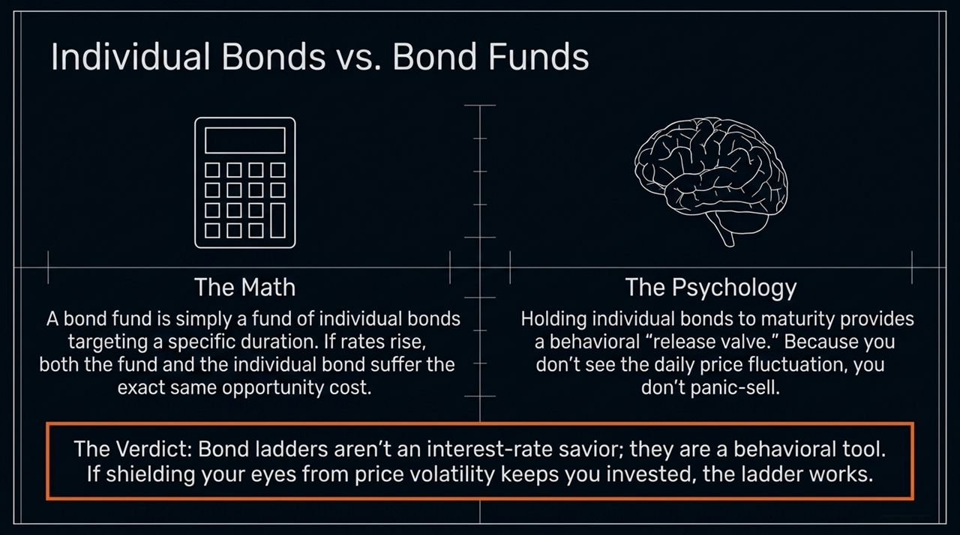
Notes:
The Math: There is a heated debate among investors regarding individual bond ladders versus bond funds. Mathematically, a bond fund is simply a portfolio of individual bonds targeting a specific duration. If interest rates jump, both individual bonds and bond funds experience the exact same underlying opportunity cost.
The Psychology: Where they differ is in human behavior. Holding individual bonds to maturity provides a psychological release valve. Investors don't see a daily fluctuating ticker price, which prevents panic-selling.
Verdict: Bond ladders aren't a mathematical cure for interest-rate risk; they are a behavioral tool. If hiding daily price fluctuations keeps you disciplined, a ladder is worthwhile.

Slide 8
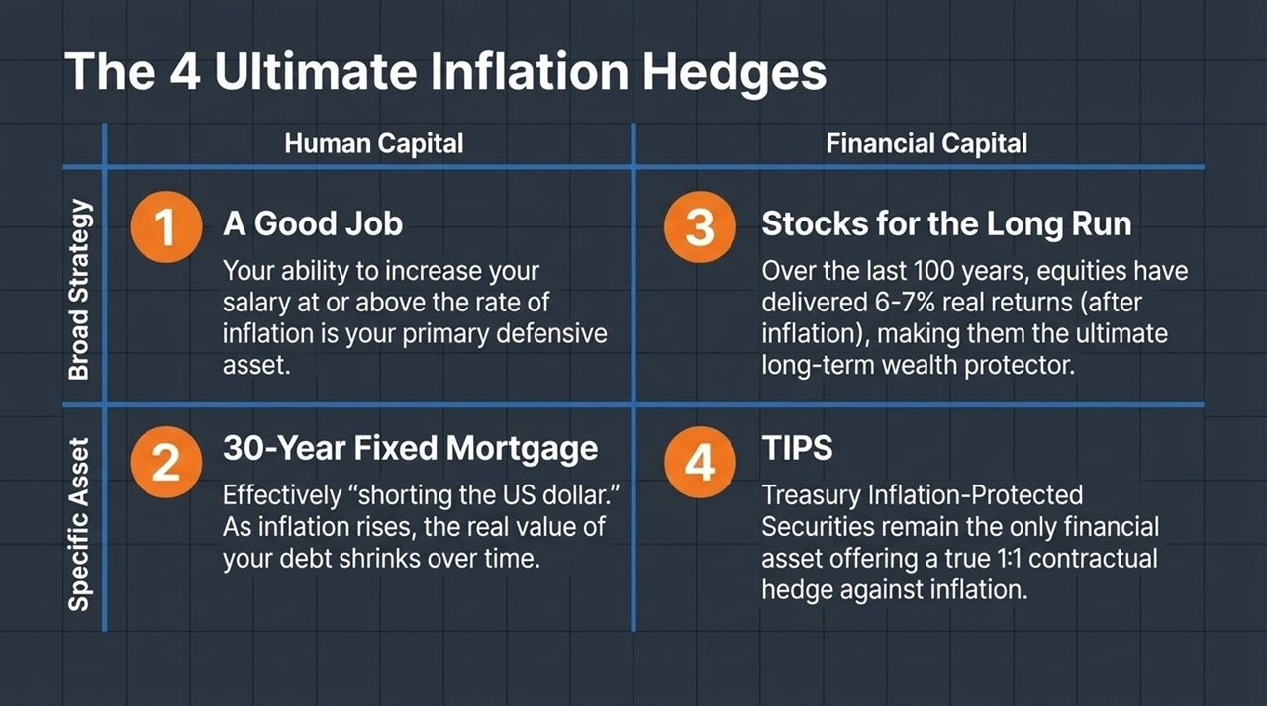
Notes:
Focus Beyond Financial Assets: Instead of buying obscure commodities, the best inflation hedges are rooted in foundational personal finance.
1. Human Capital: Your single greatest asset is your ability to earn an income and negotiate salary increases that match or exceed inflation.
2. 30-Year Fixed Mortgage: A fixed-rate mortgage is effectively a short position on the U.S. dollar. As inflation erodes purchasing power, the real value of your fixed debt shrinks over time while property value scales.
3. Equities: Over the past century, stocks have delivered 6% to 7% real returns above inflation, outperforming gold, cash, and real estate over long horizons.
4. TIPS: Treasury Inflation-Protected Securities stand as the only financial asset providing a direct contractual link to CPI.

Slide 9
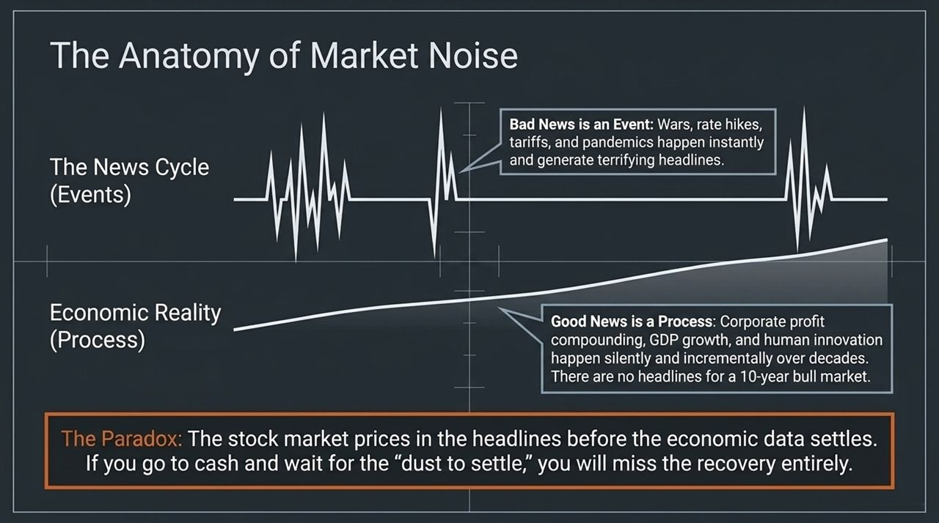
Notes:
Bad News is an Event: Crises—like wars, rate hikes, tariffs, and pandemics—happen abruptly. They trigger immediate, terrifying media headlines that demand your attention.
Good News is a Process: In contrast, economic growth, human innovation, and corporate earnings compounding occur silently over decades. There are no dramatic breaking-news alerts for a 10-year bull market.
The Market Paradox: Markets price in bad headlines long before economic data catches up. If you panic, move to cash, and wait for the 'dust to settle,' you invariably miss the sharpest market recoveries.

Slide 10
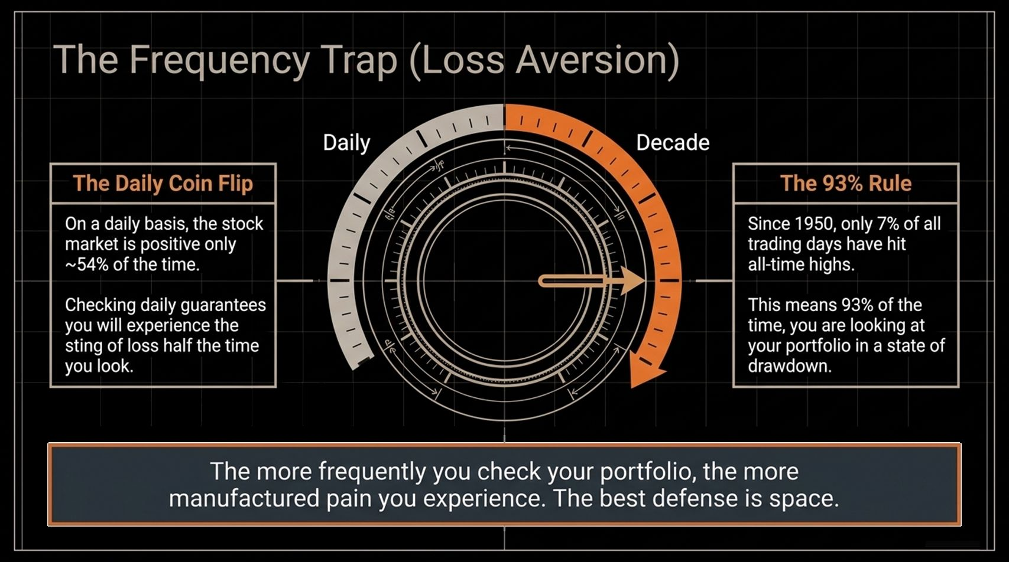
Notes:
The Daily Coin Flip: On a day-to-day basis, the stock market rises only ~54% of the time. Checking your portfolio daily guarantees you will experience loss roughly half the times you look.
The 93% Rule: Since 1950, only 7% of trading days hit brand-new all-time highs. Inverting that stat means 93% of the time, your portfolio is technically in a state of drawdown relative to its peak.
Behavioral Impact: Human beings feel the pain of a loss twice as intensely as the joy of a gain (loss aversion). Checking your investments too frequently exposes you to self-inflicted psychological distress. The best defense is distance.

Slide 11
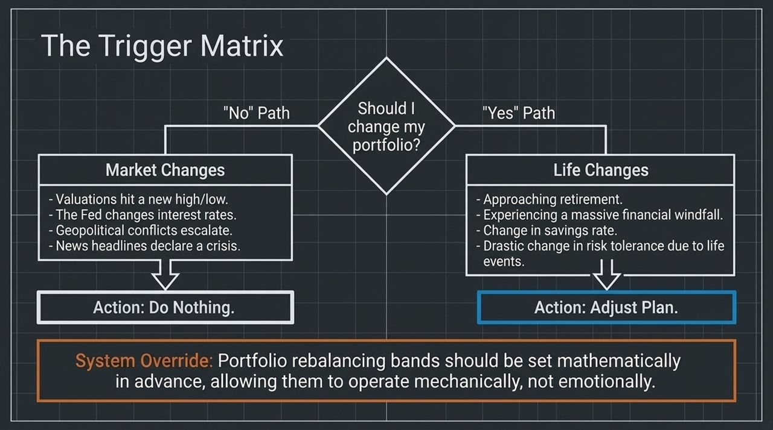
Notes:
Market Noise (No Path): When should you alter your portfolio? Valuations change, the Fed shifts rates, or geopolitical headlines erupt. The correct action to market events is almost always: Do Nothing.
Life Events (Yes Path): Portfolio modifications should be triggered by personal life events, not market movements. Approaching retirement, receiving an inheritance, or shifting your savings rate are valid reasons to adjust your plan.
System Override: Establish quantitative rebalancing bands in advance. This forces portfolio adjustments to run mechanically rather than emotionally.

Slide 12
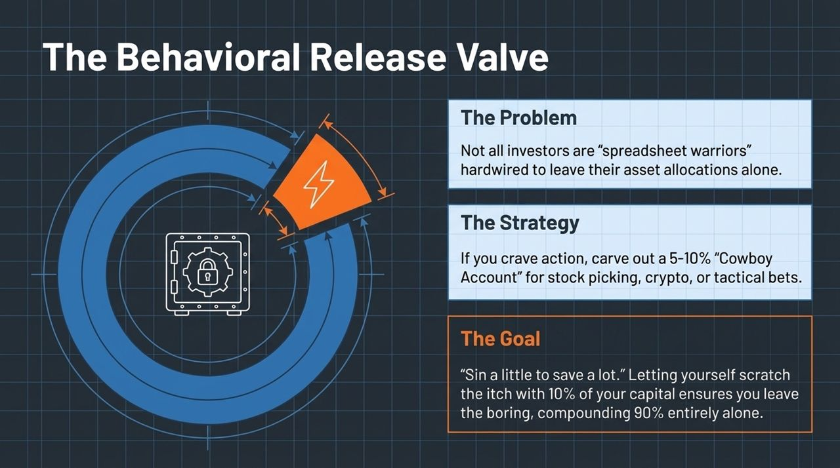
Notes:
The Problem: Not every investor is a disciplined 'spreadsheet robot' who can sit idle for decades without making trades.
The Strategy: If you need market action, set up a dedicated 'Cowboy Account' containing 5% to 10% of your total portfolio. Use this fun money for stock picking, crypto, or tactical bets.
The Goal: To quote Cliff Asness, the objective is to 'sin a little to save a lot.' Scratching your speculative itch with 10% of your capital keeps you from meddling with the core 90% that drives your retirement.

Slide 13
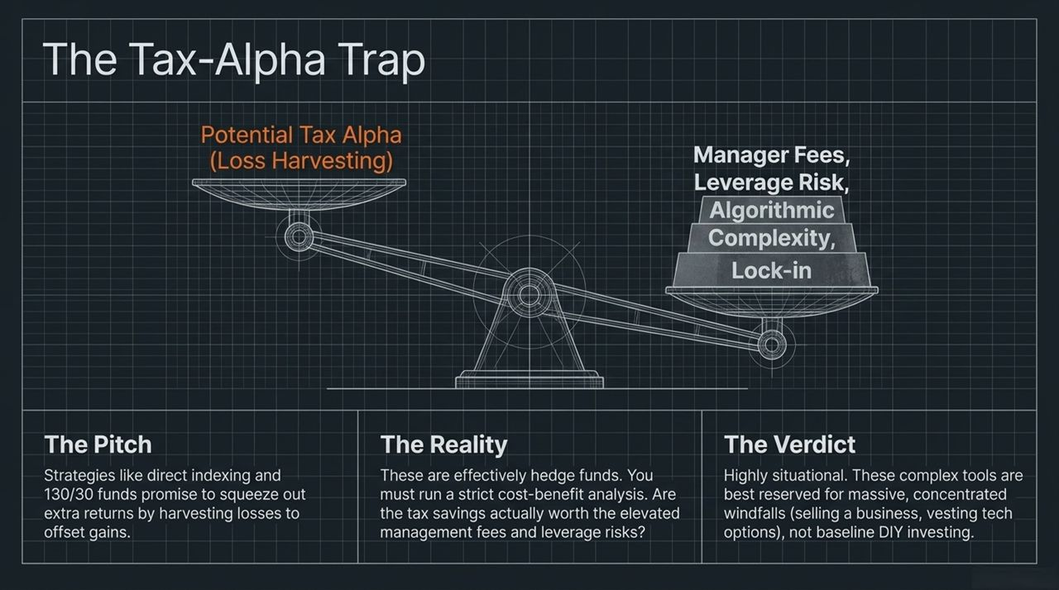
Notes:
The Pitch: Financial firms promote direct indexing and 130/30 long/short strategies, promising 'after-tax alpha' through tax-loss harvesting.
The Reality: These strategies function like complex hedge funds. While tax savings are hypothetical, management fees and leverage risks are guaranteed.
Verdict: As podcast host John Luskin points out, these complex tools are highly situational. They suit individuals managing large, concentrated windfalls (e.g., selling a business or tech options), but shouldn't replace baseline index strategies for regular investors.

Slide 14
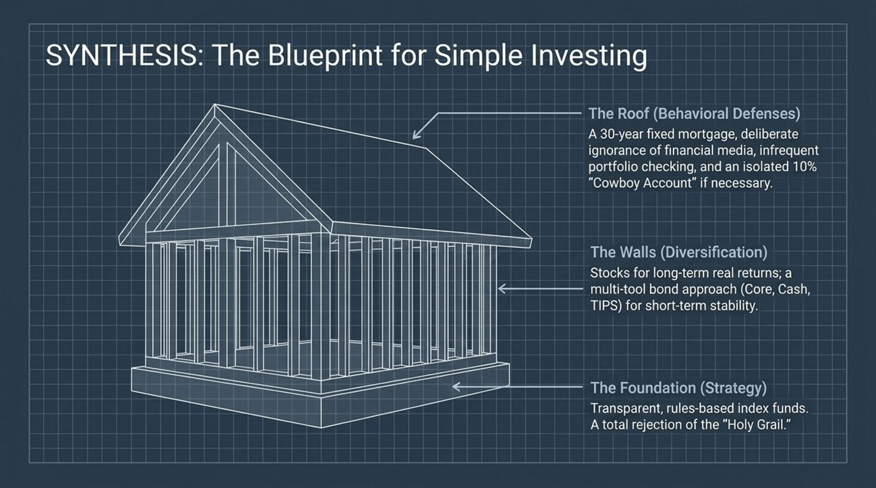
Notes:
The Foundation: Built on transparent, low-cost index funds while rejecting the search for high-fee 'Holy Grail' strategies.
The Walls (Diversification): Anchored by equities for real long-term capital growth, supported by a multi-tool fixed income strategy (Core Bonds, Cash Equivalents, and TIPS) for stability.
The Roof (Behavioral Defenses): Protected by personal inflation hedges (fixed mortgage, human capital), low portfolio checking frequency, and an isolated 5–10% Cowboy Account if needed to maintain discipline.

Slide 15
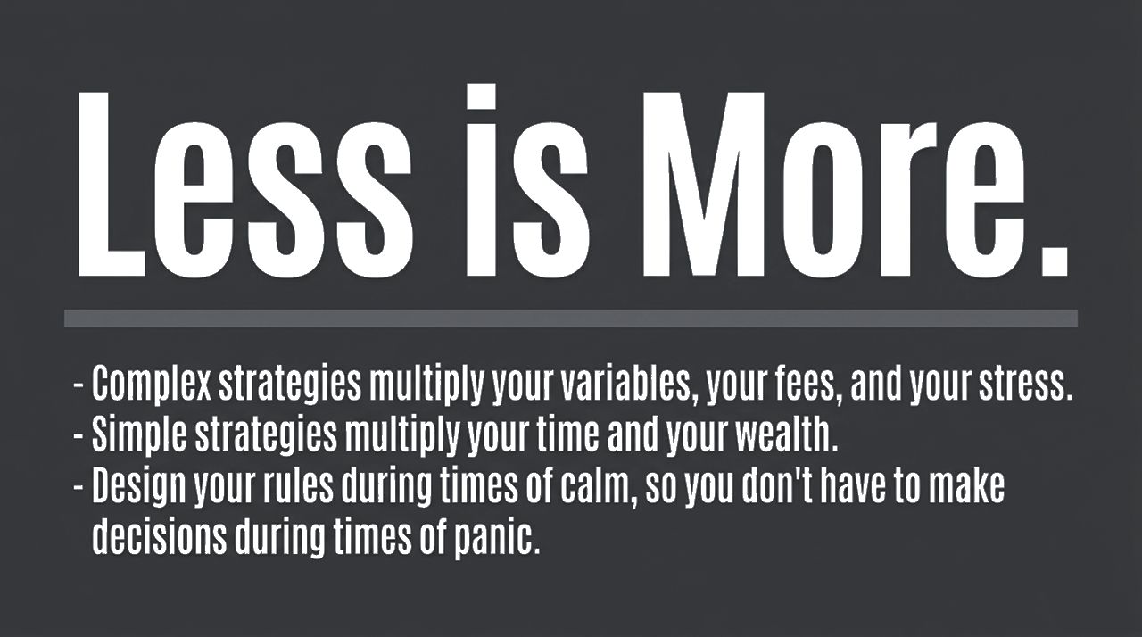
Notes:
Core Takeaways:
Complex strategies multiply variables, management fees, tax complications, and personal stress.
Simple strategies multiply time, peace of mind, and long-term wealth.
Formulate your investment rules during periods of market calm so you don't make impulsive decisions during moments of panic.
Closing Phrase: In the words Ben Carlson leaves us with: Less is more.

Slide 16
